Slide 1
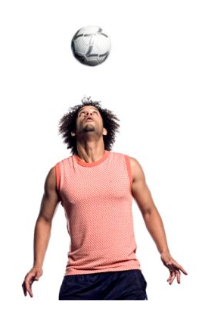
Conservation of Mechanical Energy

Slide 2
Energy:
The ability to do WORK or to alter the surroundings
in some way.
Work is done when a force acts on an object and
the object undergoes a displacement in the direction of
the force.
Energy Examples: kinetic energy
gravitational potential energy
thermal energy
Law of Conservation of Energy:
created
destroyed
Energy can neither be __________ nor _____________.
Energy can be___________________ from one form
to another.
transformed

Slide 3
Total Mechanical Energy is conserved in cases where an object is moving freely in a gravitational field -friction and air resistance are ignored
Examples:
Ball is thrown up in the air after leaving thrower’s hand
“gravity rides” like roller coaster
pendulum swinging

Slide 4
E_{T} = E_{g} + E_{k}
_{OR}
E_{g1} + E_{k1} = E_{g2} + E_{k2}
In a Closed System (i.e. Physics Problem):
The Total Energy (E_{T}) is the same at ALL positions in the system

Slide 5
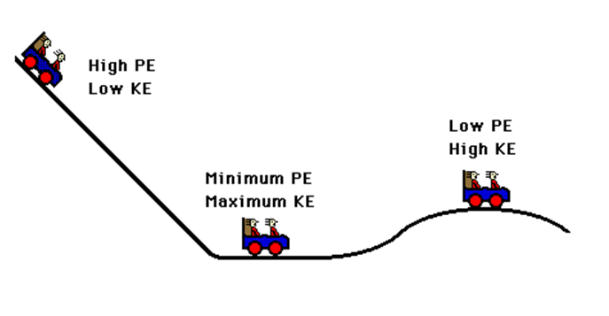
Examples: Roller Coaster
As the car falls it loses ________________ energy and gains ___________ energy
potential
kinetic
potential
As the car rises it loses ________________ energy and gains ___________ energy
kinetic
constant
The SUM of the kinetic energy and potential energy is _______________.

Slide 6
Gizmos Energy In A Pendulum

Slide 7
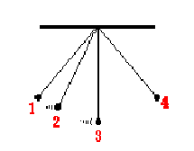




Example 2: A Simple Pendulum
Assume the pendulum is released from rest from position 1
0 J
6 J
2 J
Energy is converted between Potential Energy and Kinetic Energy but the TOTAL ENERGY is CONSTANT!!

Slide 9
Conservation Sample #1
A high school student shoots a 0.040 kg arrow straight up in the air at 30.0 m/s during archery class in the school gym.
Assuming no air resistance, what is the maximum height that the arrow could reach?
What is the kinetic energy of the arrow when it strikes the ceiling at a height of 15.0 m?
How fast is the arrow going when it strikes the ceiling?
Position | H - Height | E_{G} (mgh) | V - Speed | E_{K} (1/2mv²) | E_{T} (Total Energy)
Top
Middle
Bottom

Slide 10
Conservation Sample #2
Problem: A 0.550 kg ball is thrown down from a cliff 30.0 m high with a speed of 5.00 m/s. Assume air resistance is negligible.
The ball’s initial kinetic, gravitational potential and total mechanical energy.
Find the ball’s potential energy at a height of 10.0 m above the ground and it’s kinetic energy at that height.
Find the ball’s speed just before it hits the ground.
Position | H - Height | E_{G} (mgh) | V - Speed | E_{K} (1/2mv²) | E_{T} (Total Energy)
Top
Middle
Bottom

Slide 11
Problem: A 0.550 kg ball is thrown down from a cliff 30.0 m high with a speed of 5.00 m/s. Assume air resistance is negligible.
Find:
a) The ball’s initial kinetic, gravitational potential and total
mechanical energy.
b) Find the ball’s potential energy at a height of 10.0 m
above the ground and it’s kinetic energy at that height.
c) Find the ball’s speed just before it hits the ground.
Ans: 1.a) E_{k1}=6.88 J, E_{g1}=162 J E_{T}=169 J
b) E_{g2}= 54.0 J, E_{k2}= 115J
c) v_{final} = 24.8 m/s

